Slide 1
Processing symbolic number in the human brain
Seppe Santens & Tom Verguts

Slide 2
my PhD project
Verguts and Fias (2004): separate routes for processing
nonsymbolic number:
symbolic number:
PhD
intro
part I
part II
part III
2
4

Slide 3
my PhD project
PhD
intro
part I
part II
part III

Slide 4
my PhD project
PhD
intro
part I
part II
part III

Slide 5
my PhD project
PhD
intro
part I
part II
part III
3

Slide 6
my PhD project
PhD
intro
part I
part II
part III
3

Slide 7
PhD
intro
part I
part II
part III

Slide 8
my postdoc project
?
PhD
intro
part I
part II
part III
3

Slide 9
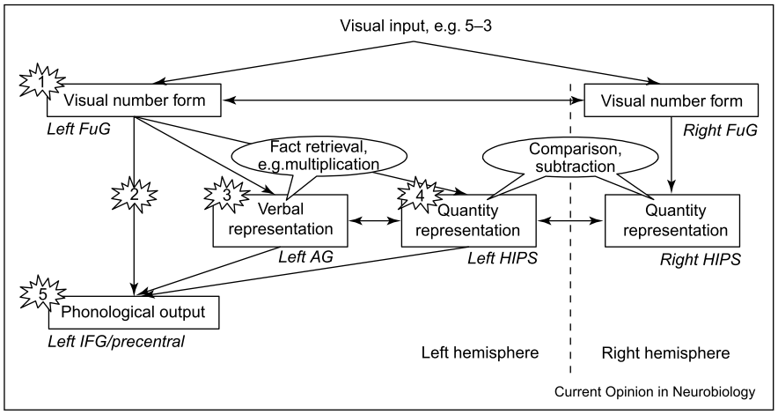
model of symbolic number processing (Dehaene et al., 2004)
PhD
intro
part I
part II
part III
based on earlier presented triple code model(s)

Slide 10
model of symbolic number processing (Dehaene et al., 2004)
fusiform (occipitotemporal) gyrus:
visual recognition of digits by assimilating features (“visual number form area”)
BUT: only sporadically reported / discussed in number processing / arithmetic imaging studies
angular gyrus:
verbal retrieval of numbers / arithmetic facts
BUT: exact role remains unclear
PhD
intro
part I
part II
part III

Slide 11
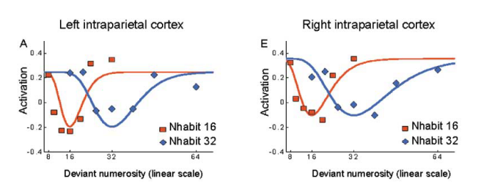
part I: in search of the visual number form area
adaptation design (Piazza et al., 2004, 2007):
32 32 31 32 16 32 34 60 33 25 32 …
IPS:
PhD
intro
part I
part II
part III

Slide 12
part I: in search of the visual number form area
adaptation design:
32 32 31 32 16 32 34 60 33 25 32 …
FuG: presenting a different number leads to adaptation, but in an all-or-nothing manner, not in a distance-dependent manner
PhD
intro
part I
part II
part III

Slide 13
part I: in search of the visual number form area
adaptation design:
32 32 32 32 16 32 34 60 33 25 32 …
visual areas: do not get adapted to the different presentation forms (font, size, color,…) of the same number
PhD
intro
part I
part II
part III

Slide 14
part II: investigating the role of FuG and AG during arithmetic
testing the functional connectivity
e.g. with dynamic causal modelling (DCM) analyses
between visual input areas, IPS, FuG and AG
while participants are doing arithmetic
subtraction vs multiplication
PhD
intro
part I
part II
part III

Slide 15
part II: investigating the role of FuG and AG during arithmetic
subtraction:
PhD
intro
part I
part II
part III

Slide 16
part II: investigating the role of FuG and AG during arithmetic
multiplication:
PhD
intro
part I
part II
part III

Slide 17
part I and part II
part I
identification of VNFA
part II
connectivity between different areas
result: basic neuroanatomical model of symbolic number processing
PhD
intro
part I
part II
part III

Slide 18
part III
FuG and especially AG have been implicated in dyscalculia
parallels between symbolic number processing and reading:
same areas involved (FuG, AG), both for normal and impaired functioning
high comorbidity between dyslexia and dyscalculia
PhD
intro
part I
part II
part III

Slide 19
part III
can the basic neuroanatomical model account for impaired processing in dyscalculia?
replication of part II
comparing connectivity between different brain areas between people with and without dyscalculia
how should the model be adapted to account for dyslexia?
PhD
intro
part I
part II
part III

Slide 20
all suggestions are welcome…
PhD
intro
part I
part II
part III

